Slide 1
The Jewelry and Craft Project
Our sponsors
Virginia Obando
Family Advocate
Intercultural Advocacy Institute

Slide 2
Women belong in all places where decisions are being made. … It shouldn't be that women are the exception..”
- Ruth Bader Ginsburg

Slide 3
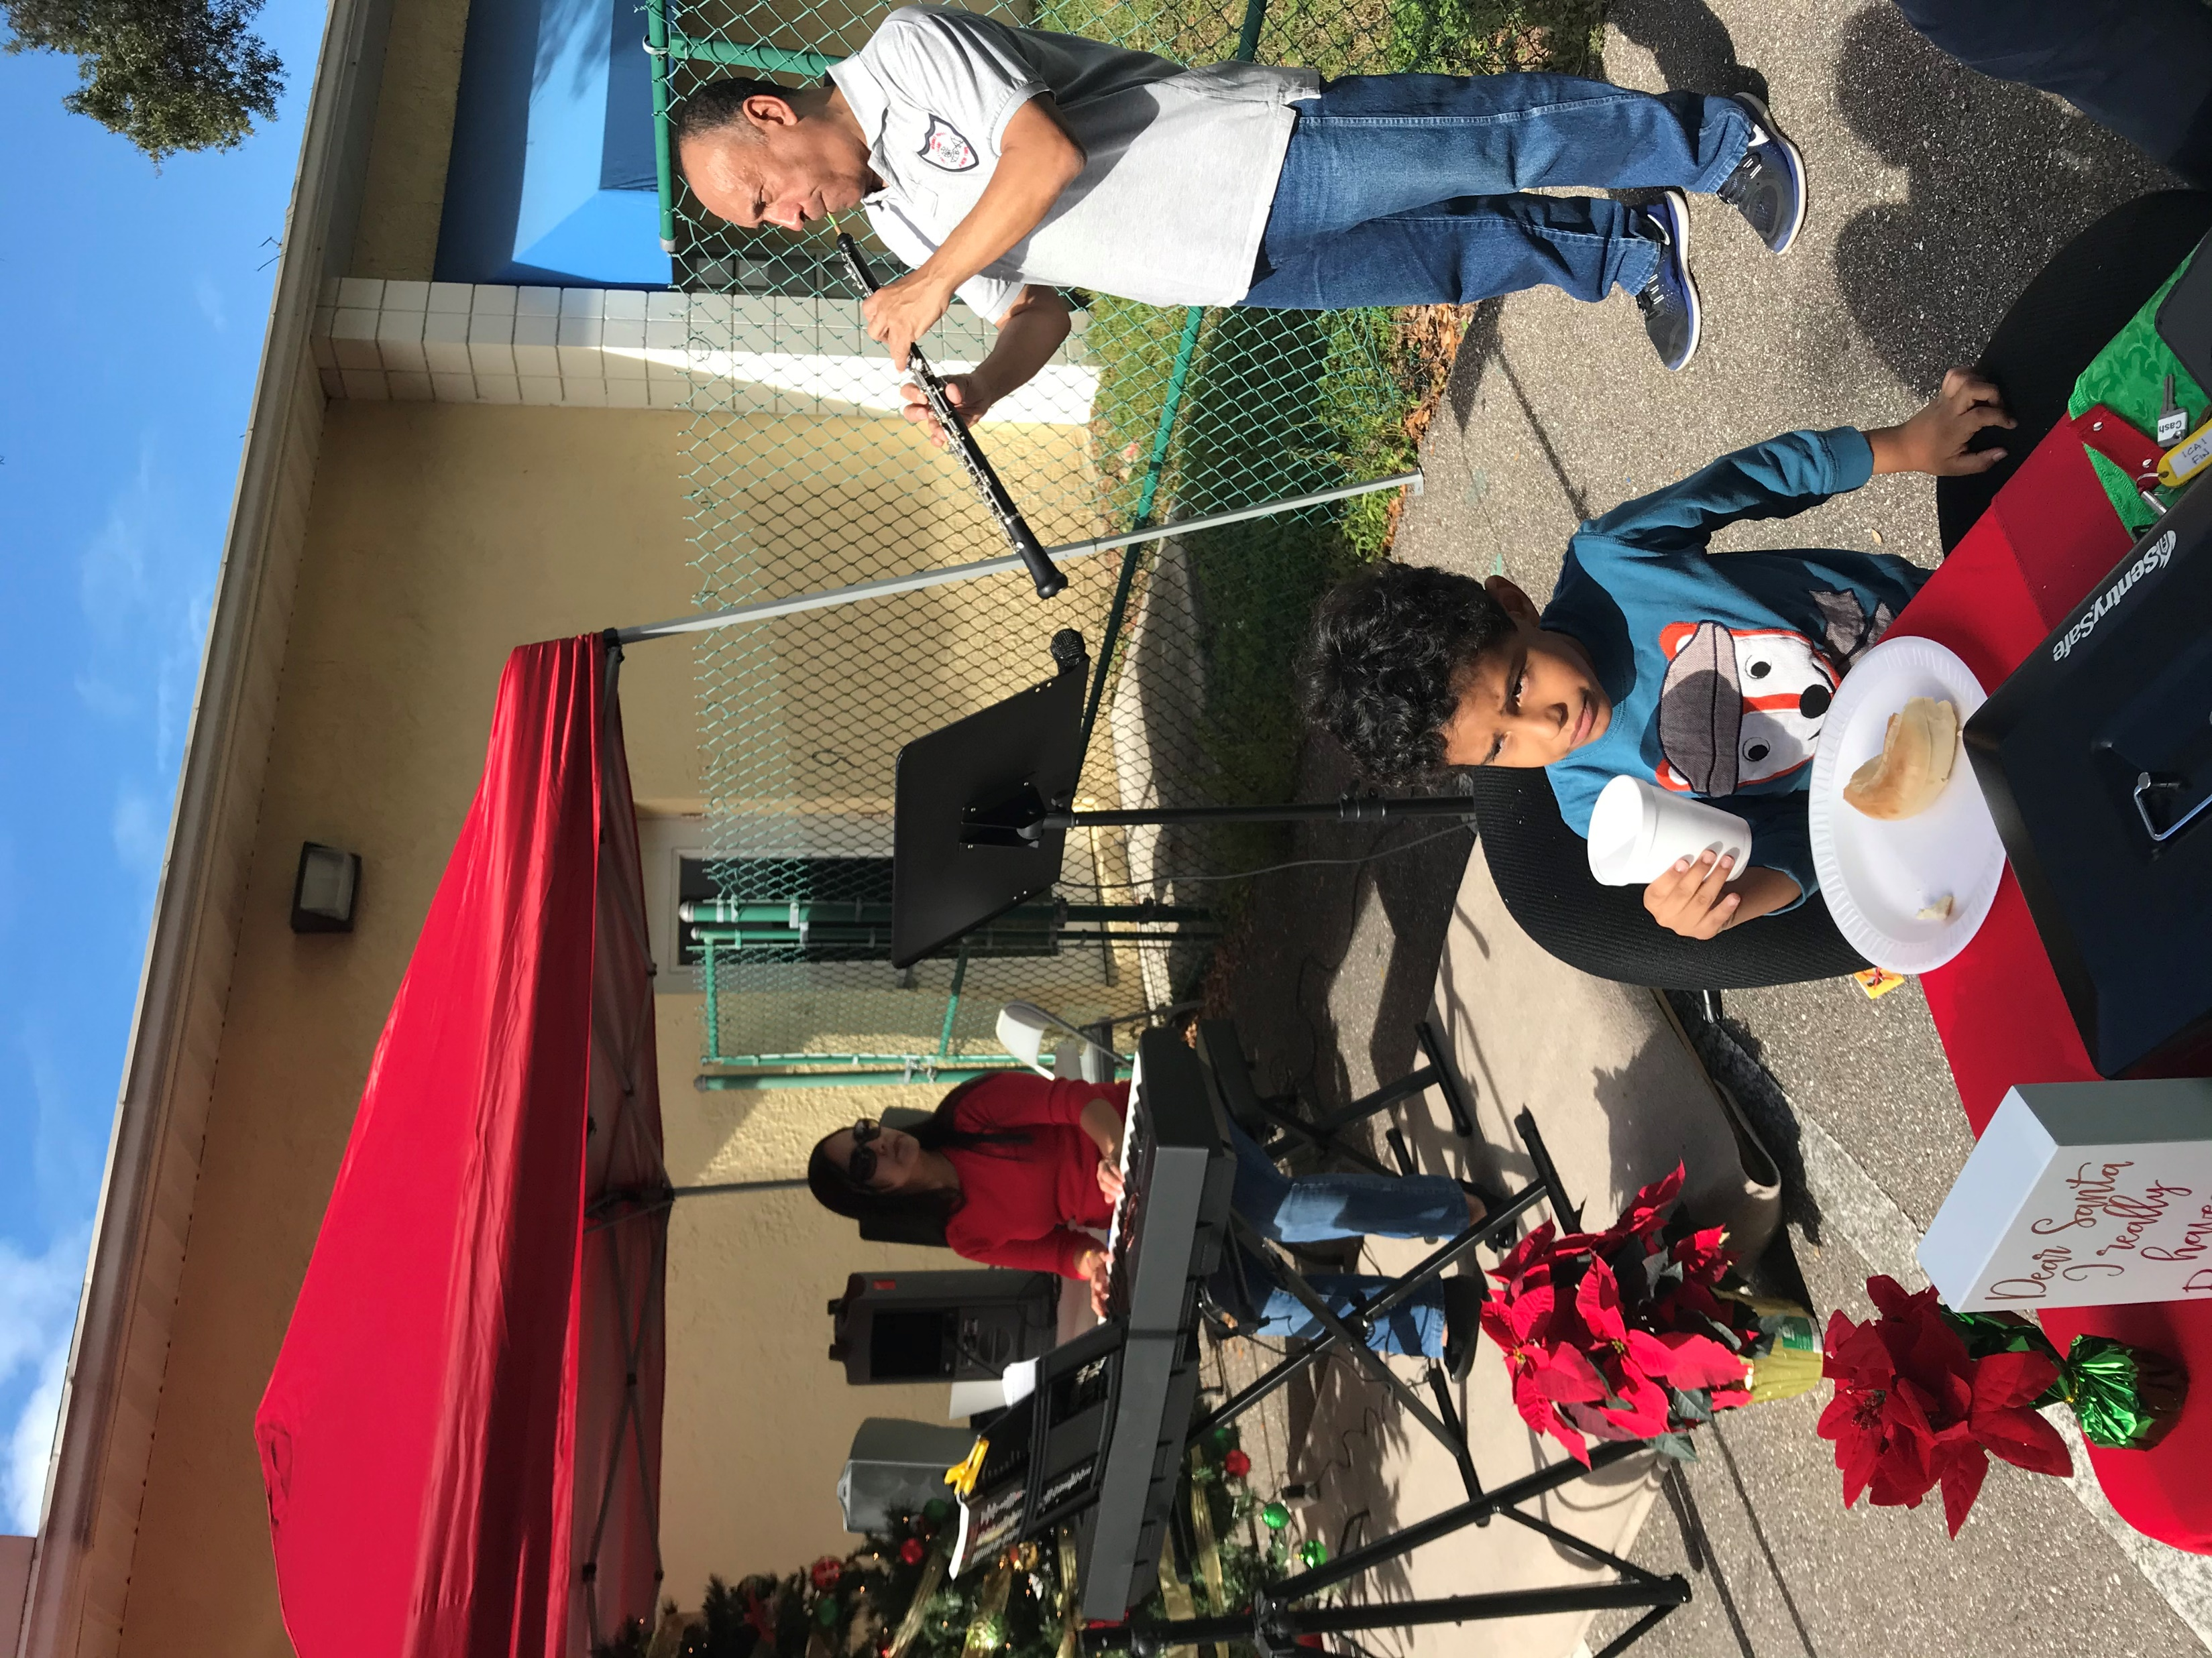
Fall 2019 and Spring 2020 were Seasons full of work. Our participants have shown their skills in many ways.
The community has participated supporting this event, not only buying their goods also providing music and entertainment.
It is Inspiring!

Slide 4
Happiness and comfort have been successfully reached

Slide 5
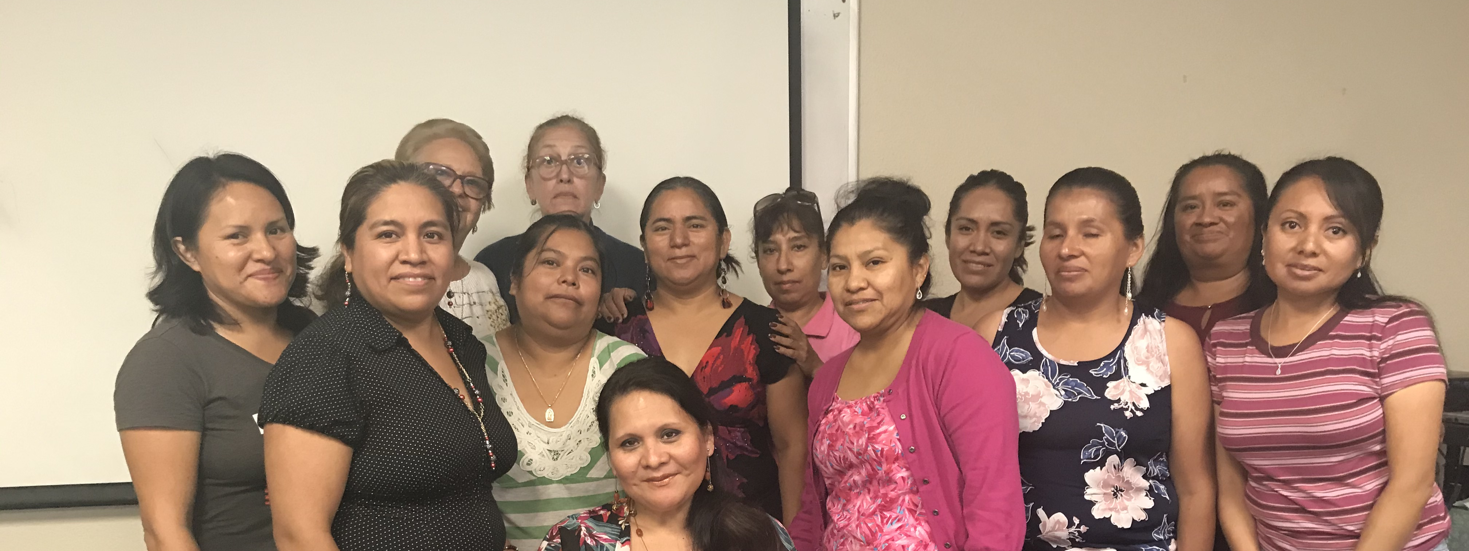
The participants are regularly attending to our classes through every season
Six new participants in both seasons have increased. They are learning from the assigned team leaders in order to expand the learning process.

Slide 6
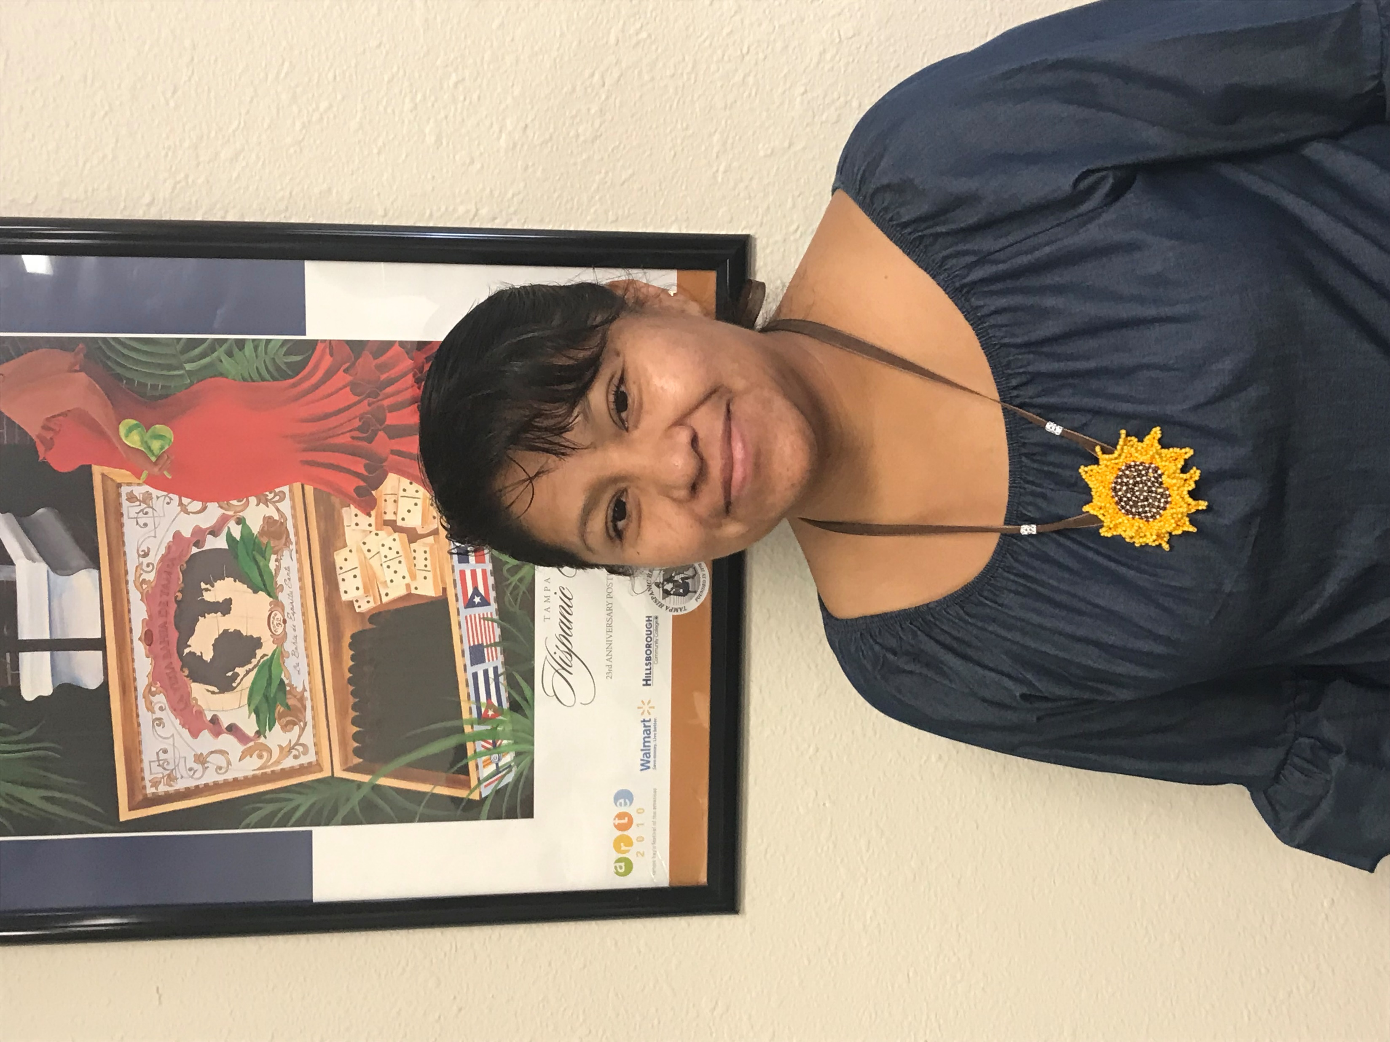
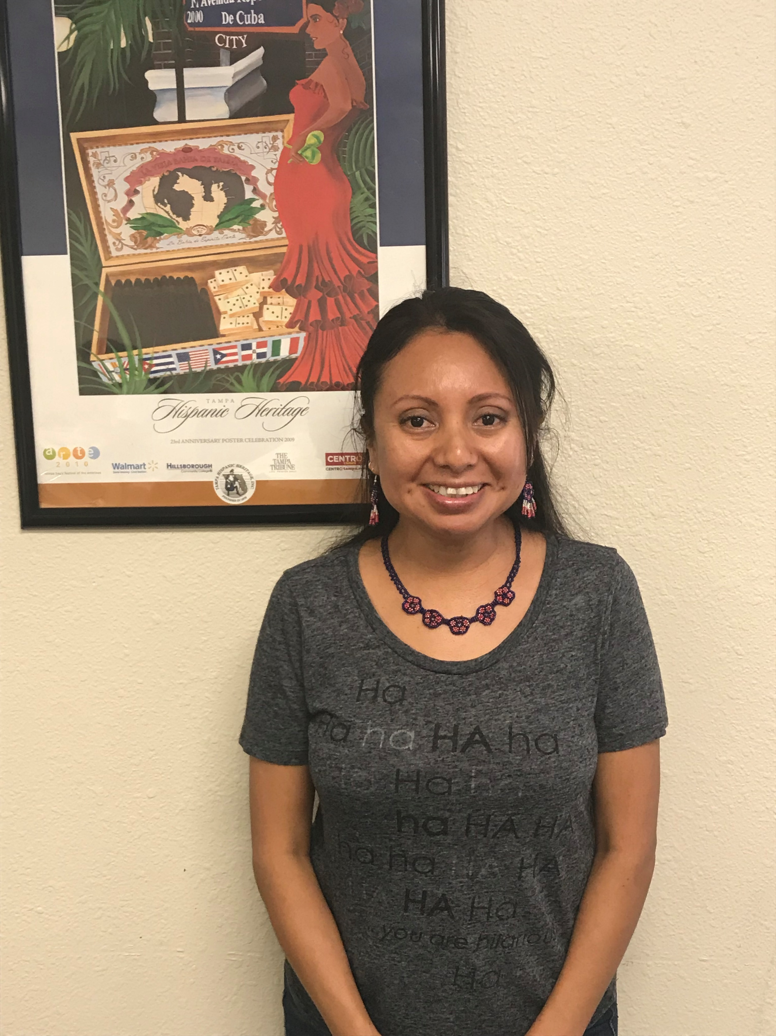
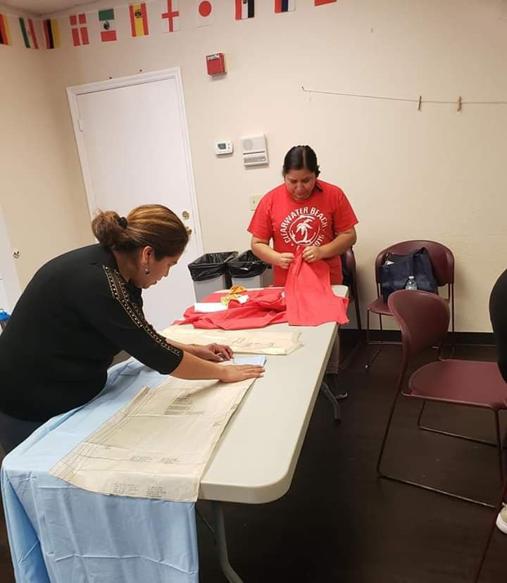
The leadership of the participants is crucial in the learning process. Veronica and Carolina have demonstrated outstanding leader skills of the Jewelry Program 2019-2020.
Veronica Tejamanil
Carolina Espitia
New Skills were developed during classes.
They have learned how to sew their own blouses and decorating them with embroidered flowers made by themselves as well.
They have participating also in local fairs from churches that provides the healthy space for our participants.

Slide 7
ATTENDANCE REPORT
FALL 2019
SPRING 2020
Total Classes 29
From Aug. to Dec. twice a week Monday and Wednesday
From 9:00 am. to 12:00 pm.
Attendance Average 85%
Total Participants 15
New Participants 2
Graduated 14
Total Classes 31 Attended 19
From Jan. to April twice a week Monday and Wednesday
From 9:00 am. to 12:00 pm.
Attendance Average 83%
Total Participants 17
New Participants 4
COVID-19 did not let us finished our program No Graduation

Slide 8
Special Thanks to
For believe in our projects,
For being supportive through out this challenge
For being our partner
And
for continue with us!

